Slide 1


Building a Blockchain
Building a Node (Peers + Blocks + Transactions), Wallet App, Miners, Faucet, Block Explorer
Svetlin Nakov
Blockchain Trainer
Academy School of Blockchain
http://kingsland.academy

Slide 2


Table of Contents
Building a Blockchain Node
Peers, Blocks, Transactions, Addresses, Balances
Designing the REST API
Blockchain System Architecture
Building the Mining Software
Building a Faucet App
Building a Wallet App
Building an Block Explorer Site

Slide 3
Blockchain System Architecture
Node
Node
Miner
Node
Wallet
Block Explorer
Faucet
Nodes, Miners, Faucet, Wallets, Explorer

Slide 4
Blockchain System Architecture
Node
Wallet
Block Explorer
Peers
Blocks
Transactions
Balances
Mining jobs
Keep private keys
Check balances
Send transactions
View blocks
View confirmed transactions
View pending transactions
View accounts and balances
View peers map
Miner
Faucet
Get mining block
Mine (PoW)
Submit result
Request 5 coins

Slide 5
Keys and Addresses
Elliptic curve cryptography (ECC), using the secp256k1 curve
private key
privKey
public key
= privKey * G
address
= ripemd(pubKey)
256-bit number
64 hex digits
{x, y} - 256-bit numbers
compressed: {x, 0/1}
65 hex digits
RIPEMD-160 of the compressed public key
40 hex digits
7e4670ae70c98d24f3662c172dc510a085578b9ccc717e6c2f4e547edd960a34
c74a8458cd7a7e48f4b7ae6f4ae9f56c5c88c0f03e7c59cb4132b9d9d1600bba1
c3293572dbe6ebc60de4a20ed0e21446cae66b17

Slide 6
Coins and Rewards
Coins are 64-bit integers (no real numbers!)
1 coin = 1 000 milli-coins = 1 000 000 micro-coins
All transfers, fees, block awards are defined in micro-coins
The block reward (per mined block) is static
5 000 000 micro-coins
The minimum transaction fee (to avoid spam) is
10 micro-coins

Slide 7
Building the Blockchain Node
Chain, Blocks, Transactions, Addresses, Balances, Peers & Sync, Designing the REST API

Slide 8
Building the Blockchain Node
Node
Blockchain
SelfUrl: URL
Peers: URL[]
Chain: Blockchain
REST Endpoints
Blocks: Block[]
PendingTransactions: Transaction[]
CurrentDifficulty: integer
MiningJobs: map(blockDataHash => Block)
Node: holds peers + network communication (REST API for simplicity)
Blockchain: holds the blocks + transactions + mining pool
Consensus algorithm: proof of work (SHA256 hashing)
The chain with most work (~ the longest) is the main chain

Slide 9
REST Endpoints: Info
GET
http://{host}:5555/info
{ "about": "SoftUniChain/0.9-csharp",
"nodeId": "1a22d3…9b2f", chainId: "c6da93eb…c47f",
"nodeUrl": "http://chain-node-03.herokuapp.com",
"peers": 2, "currentDifficulty": 5,
"blocksCount": 25, "cumulativeDifficulty": 127
"confirmedTransactions": 208, "pendingTransactions": 7
}
200 OK
nodeId == unique node ID (based on datetime + random)
chainId == the hash of the genesis block
Nodes can provide additional info by choice

Slide 10
REST Endpoints: Debug Info (All Node Data)
GET
http://{host}:5555/debug
{ "selfUrl": "http://localhost:5555", "peers": […],
"chain": {
"blocks": [{"index": 0, "transactions":[…], "difficulty": 0,
"prevBlockHash": "d9…9c", "minedBy": "af…b2", "nonce": 0,
"blockDataHash": "af25…d9", "dateCreated": "2018-01-…"},
"blockHash": "c962…a8"}, {…}, {…}],
"pendingTransactions": [{…}, …], "currentDifficulty": 5,
"miningJobs": {"e3d8…5f": {…}, "e3d8…5f": {…}, }
}, "confirmedBalances": {"2a7e…cf": 500020, … }
}
200 OK
Provide as much info as possible (to simplify debugging)

Slide 11
Building the Blockchain Node: Blocks
Block
Index: integer (unsigned)
Transactions: Transaction[]
Difficulty: integer (unsigned)
PrevBlockHash: hex_number[64]
MinedBy: address (40 hex digits)
BlockDataHash: hex_number[64]
Nonce: integer (unsigned)
DateCreated: ISO8601_string
BlockHash: hex_number[64]
SHA256
Assigned by the miners

Slide 12
Calculating the Block Data Hash
The block data hash is calculated by SHA256 hashing the JSON representation of following block fields (in exactly this order):
'index'
'transactions', each holding these fields:
'from', 'to', 'value', 'fee', 'dateCreated', 'data', 'senderPubKey', 'transactionDataHash', 'senderSignature', 'minedInBlockIndex', 'transferSuccessful'
'difficulty', 'prevBlockHash', 'minedBy'

Slide 13
REST Endpoints: All Blocks
GET
http://{host}:5555/blocks
[ {
"index": 17,
"transactions": […],
"difficulty": 5,
"prevBlockHash": "d279fa6a31ae4fb07cfd9cf7f35cc01f…3cf20a",
"minedBy": "91c43337992580bca7d5f758d09e88f9b7032a65",
"blockDataHash": "5d845cddcd4404ecfd5476fd6b1cf0e5…a80cd3",
"nonce": 2455432,
"dateCreated": "2018-02-01T23:23:56.337Z",
"blockHash": "00000abf2f3d86d5c000c0aa7a425a6a4a65…cf4c"
}, {…}, {…}, …]
200 OK

Slide 14
REST Endpoints: Block by Number
GET
http://{host}:5555/blocks/11
{
"index": 11,
"transactions": […],
"difficulty": 4,
"prevBlockHash": "e69cb1368aa174c9e5548f4e5adb0d3b4c6c…ef25",
"minedBy": "91c43337992580bca7d5f758d09e88f9b7032a65",
"blockDataHash": "5d845cddcd4404ecfd5476fd6b1cf0e5…a80cd3",
"nonce": 2455432,
"dateCreated": "2018-02-01T22:58:23.129Z",
"blockHash": "d2c6ee29ff14b49e31c409af985824ea12afccc8…e4cd"
}
200 OK / 404 Not Found

Slide 15
Building the Blockchain Node: Transactions
Transaction
From: address (40 hex digits)
To: address (40 hex digits)
Value: integer (non-negative)
Fee: integer (non-negative)
DateCreated: ISO8601_string
Data: string (optional)
SenderPubKey: hex_number[65]
TransactionDataHash: hex_number
SenderSignature: hex_number[2][64]
MinedInBlockIndex: integer / null
TransferSuccessful: bool
SHA256
Sign by private key
Assigned when a new block is mined

Slide 16
REST Endpoints: Get Pending Transactions
GET
http://{host}:5555/transactions/pending
[{
"from": "44fe0696beb6e24541cc0e8728276c9ec3af2675",
"to": "9a9f082f37270ff54c5ca4204a0e4da6951fe917",
"value": 25000, "fee": 10,
"dateCreated": "2018-02-10T17:53:48.972Z", "data": "…",
"senderPubKey": "2a1d79fb8743d0a4a8501e0028079bcf82a4f…eae1",
"transactionDataHash": "4dfc3e0ef89ed603ed54e47435a18…176a",
"senderSignature": ["e20c…a3c29df79f", "cf92…0acd0c2ffe56"]
},
{ … }, { … }]
200 OK

Slide 17
REST Endpoints: Get Confirmed Transactions
GET
http://{host}:5555/transactions/confirmed
[{
"from": "44fe0696beb6e24541cc0e8728276c9ec3af2675",
"to": "9a9f082f37270ff54c5ca4204a0e4da6951fe917",
"value": 25000, "fee": 10,
"dateCreated": "2018-02-10T17:53:48.972Z", "data": "…",
"senderPubKey": "2a1d79fb8743d0a4a8501e0028079bcf82a4f…eae1",
"transactionDataHash": "4dfc3e0ef89ed603ed54e47435a18…176a",
"senderSignature": ["e20c…a3c29df79f", "cf92…0acd0c2ffe56"]
"minedInBlockIndex": 7, "transferSuccessful": true
}, { … }, { … }]
200 OK

Slide 18
Calculating the Transaction Data Hash
The transaction data hash uniquely identifies a transaction
Like in Etherscan: https://etherscan.io/tx/0xb03b6c7ef5c555001b41c32e5ac2c600c5e2c72b6918b3d68c0f3dd4b5cb54a8
Calculated by the transaction data fields only:
'from', 'to', 'value', 'fee', 'dateCreated', 'data', 'senderPubKey'
Does not include the signature and execution info (the mined block index + success of the execution)
Pending and unsigned transactions also have data hash (unique ID)

Slide 19
REST Endpoints: Get Transaction by Hash
GET
http://{host}:5555/transactions/44fc3ee0f89ed6003…176a
200 OK / 404 Not Found
{
"from": "44fe0696beb6e24541cc0e8728276c9ec3af2675",
"to": "9a9f082f37270ff54c5ca4204a0e4da6951fe917",
"value": 25000, "fee": 10,
"dateCreated": "2018-02-10T17:53:48.972Z", "data": "…",
"senderPubKey": "2a1d79fb8743d0a4a8501e0028079bcf82a4…eae1",
"transactionDataHash": "4dfc3e0ef89ed603ed54e47435a18…176a",
"senderSignature": ["e20c…a3c29df79f", "cf92…0acd0c2ffe56"],
"minedInBlockIndex": 7,
"transferSuccessful": true
}
The last two fields appear only after the transaction is mined

Slide 20
REST Endpoints: List All Account Balances
GET
http://{host}:5555/balances
{
"0000000000000000000000000000000000000000": -1000340000110,
"f3a1e69b6176052fcc4a3248f1c5a91dea308ca9": 999998382585,
"84ede81c58f5c490fc6e1a3035789eef897b5b35": 340000110,
"a1de0763f26176c6d68cc77e0a1c2c42045f2314": 894961,
"b3d72ad831b3e9cdbdaeda5ff4ae8e9cf182e548": 709999,
"a2de0763f26176c6d68cc77e0a1c2c42045f2314": 12345
}
200 OK
Lists all accounts that have non-zero confirmed balance
The all-zeros-address (null) will have negative balance

Slide 21
REST Endpoints: List Transactions for Address
GET
http://{host}:5555/address/44fe…2a75/transactions
{
"address": "44fe0696beb6e24541cc0e8728276c9ec3af2a75",
"transactions": [{ … }, { … }, { … }]
}
200 OK / 404 Not Found
All transactions, associated with the given address are returned
Confirmed transactions (successful or not) + pending transactions
Order the transactions by date and time (ascending)
Pending transactions will not have minedInBlockIndex

Slide 22
REST Endpoints: Get Balances for Address
GET
http://{host}:5555/address/44fe…2a75/balance
{
"safeBalance": 120,
"confirmedBalance": 115,
"pendingBalance": 170
}
200 OK / 404 Not Found
The safe confirm count = 6
The address balance is calculated by iterating over all transactions
For each block and for each successful transaction for the specified address, sum the values received and spent, matching the confirmations count

Slide 23
Balances for Address
Each address has 3 types of balances
safeBalance – 6 confirmations or more confirmations
confirmedBalance – 1 or more confirmations
pendingBalance – expected balance (0 confirmations)
After assuming that all pending transactions will be successful
Each successful received transaction adds value
All spent transactions subtract the transaction fee
Successful spent transactions subtract value

Slide 24
REST Endpoints: Balances Invalid for Address
GET
http://{host}:5555/address/invalidAddress/balance
{
"safeBalance": 0,
"confirmedBalance": 0,
"pendingBalance": 0
}
200 OK / 404 Not Found
Return zero balances for non-active addresses (no transactions)
For invalid addresses:
Return "404 Not Found" with errorMsg = "Invalid address"

Slide 25
Creating a Transaction
To create a transaction you need:
Sender public key – 65 hex digits; Recipient address (to) – 40 hex digits
Transfer value – positive integer; Fee for the miners – positive integer
Date & time (to avoid replay attacks) – ISO8601 UTC datetime string
Transaction data (payload / comments) – optional string
The sender's address (from) is extracted from the public key
{ "from": "c3293572dbe6ebc60de4a20ed0e21446cae66b17",
"to": "f51362b7351ef62253a227a77751ad9b2302f911",
"value": 25000, "fee": 10, "dateCreated": "2018-02-10T17:53:48.972Z",
"senderPubKey": "c74a8458cd7a7e48f4b7ae6f4ae9f56c5c88c0f03e7…bba1"
}

Slide 26
Signing a Transaction
To sign a transaction, a private + public key are required
First, put the transaction data in a JSON object (without signature)
Fields order: 'from', 'to', 'value', 'fee', 'dateCreated', 'datа', 'senderPubKey'
The from address should always match the sender public key
Remove any whitespace, calculate SHA256 and sign it
When the 'data' field is empty, remove it from the JSON
{
"from": "c3293572dbe6ebc60de4a20ed0e21446cae66b17",
"to": "f51362b7351ef62253a227a77751ad9b2302f911",
"value": 25000, "fee": 10, "dateCreated": "2018-02-10T17:53:48.972Z",
"senderPubKey": "c74a8458cd7a7e48f4b7ae6f4ae9f56c5c88c0f03e…bba1"
}

Slide 27
Signing a Transaction – Example
Sender's private key:
Corresponding public key (compressed):
Sender address:
Sample transaction data (still not signed):
7e4670ae70c98d24f3662c172dc510a085578b9ccc717e6c2f4e547edd960a34
c74a8458cd7a7e48f4b7ae6f4ae9f56c5c88c0f03e7c59cb4132b9d9d1600bba1
c3293572dbe6ebc60de4a20ed0e21446cae66b17
{ "from": "c3293572dbe6ebc60de4a20ed0e21446cae66b17",
"to": "f51362b7351ef62253a227a77751ad9b2302f911",
"value": 25000, "fee": 10, "dateCreated": "2018-02-10T17:53:48.972Z",
"senderPubKey": "c74a8458cd7a7e48f4b7ae6f4ae9f56c5c88c0f03e7…bba1" }

Slide 28
Signing a Transaction – Example (2)
JSON-serialized transaction data for signing (whitespace removed):
Transaction data hash for signing (SHA-256):
ECDSA signature of the above hash (signed signature bytes):
The ECDSA signature consists of 2 * 64 hex digits (2 * 256 bits)
{"from":"c3293572dbe6ebc60de4a20ed0e21446cae66b17","to":"f51362b7351ef62253a227a77751ad9b2302f911","value":25000,"fee":10,"dateCreated":"2018-02-10T17:53:48.972Z","senderPubKey":"c74a8458cd7a7e48f4b7ae6f4 ae9f56c5c88c0f03e7c59cb4132b9d9d1600bba1"}
9f43bfa155eece120a35c000de0d41e1d6c5cbbf201e0057548fb6bf91945a4b
r = 682d0bac85c9c9f9d5e1b32db3da6654426b260cccbb63b72c5d87bc772d63dc
s = 998317c022eb334b29112e033f26802e2f95f630fb0fbabe7aee71cdc458cfb7

Slide 29
Signing a Transaction – Example (3)
Signed transaction (the data hash + signature added in the JSON):
Use deterministic ECDSA signature, based on the curve secp256k1 and RFC-6979 with HMAC-SHA256
{ "from": "c3293572dbe6ebc60de4a20ed0e21446cae66b17",
"to": "f51362b7351ef62253a227a77751ad9b2302f911",
"value": 25000, "fee": 10, "dateCreated": "2018-02-10T17:53:48.972Z",
"senderPubKey":
"c74a8458cd7a7e48f4b7ae6f4ae9f56c5c88c0f03e7c59cb4132b9d9d1600bba1",
"transactionDataHash": "f241a5598fbe5ba048918fa1cafe8eb727794cf…e2b7",
"senderSignature": [
"682d0bac85c9c9f9d5e1b32db3da6654426b260cccbb63b72c5d87bc772d63dc",
"998317c022eb334b29112e033f26802e2f95f630fb0fbabe7aee71cdc458cfb7"
]
}

Slide 30
REST Endpoints: Send Transaction
POST
http://{host}:5555/transactions/send
{
"from": "c3293572dbe6ebc60de4a20ed0e21446cae66b17",
"to": "f51362b7351ef62253a227a77751ad9b2302f911",
"value": 25000, "fee": 10, "dateCreated": "2018-02-10T17:53:48.972Z",
"data": "first payment (50%)", "senderPubKey":
"c74a8458cd7a7e48f4b7ae6f4ae9f56c5c88c0f03e7c59cb4132b9d9d1600bba1",
"senderSignature": ["1aaf55dcb1…68b0","87250a2841…7960"]
}
201 Created / 400 Bad Request
{ "transactionDataHash": "cd8d9a345bb208c6f9b8acd6b8eef…20c8a" }
The transaction SHA256 hash is calculated when received, over all fields from the received JSON object (including the signature)

Slide 31
Send Transactions
For each received transaction the Node does the following:
Checks for missing / invalid fields / invalid field values
Calculates the transaction data hash (unique transaction ID)
Checks for collisions → duplicated transactions are skipped
Validates the transaction public key, validate the signature
Puts the transaction in the "pending transactions" pool
Checks the sender account balance to be >= value + fee
Sends the transaction to all peer nodes through the REST API
It goes from peer to peer until it reaches the entire network

Slide 32
REST Endpoints: Send Transaction → Error
POST
http://{host}:5555/transactions/send
{
"some invalid data": "some invalid value"
}
400 Bad Request
{
"errorMsg": "Invalid transaction: field 'from' is missing"
}
In case of error, the response holds a JSON object holding the error message (like shown above)

Slide 33

Peers and Synchronization
sync
sync
sync
sync

Slide 34
REST Endpoints: List All Peers
GET
http://{host}:5555/peers
200 OK
{
"162269f6993d2b5440dddcd6": "http://localhost:5556",
"162266dff5753a87a3e72403": "http://af6c7a.ngrok.org:5555",
}
Peers are described by their unique nodeId and URL
map(nodeId → url)
Each node is connected to a few neighbor peers
Not to all peers in the network

Slide 35
REST Endpoints: Connect a Peer
POST
http://{host}:5555/peers/connect
{
"peerUrl": "http://212.50.11.109:5556"
}
200 OK / 409 Conflict / 400 Bad Request
{
"message":
"Connected to peer: http://212.50.11.109:5556"
}
Always keep the connections bi-directional
If Alice is connected to Bob, then Bob should also be connected to Alice

Slide 36
Connecting to a Peer
To avoid double-connecting to the same peer
First get /info and check the nodeId
Never connect twice to the same nodeId
To ensure bi-directional connections
When Alice is connected to Bob, try to connect Bob to Alice
First check for existing connection: get /info and check the nodeId
After successful connection to a peer, try to synchronize the chain (if the peer has longer chain) + synchronize the pending transactions

Slide 37
REST Endpoints: Connect a Peer
POST
http://{host}:5555/peers/connect
{
"peerUrl": "http://212.50.11.109:5556"
}
409 Conflict
{
"errorMsg":
"Already connected to peer: http://212.50.11.109:5556"
}
If a node is already connected to given peer, return "409 Conflict"

Slide 38
REST Endpoints: Notify Peers about New Block
POST
http://{host}:5555/peers/notify-new-block
{ "blocksCount": 51, "cumulativeDifficulty": 283,
"nodeUrl": "http://chain-node-03.herokuapp.com:5555" }
200 OK
{ "message": "Thank you for the notification." }
A peer should notify all its connected peers when
A new block is mined or new valid block is received from some peer
A longer chain was arrived (synchronized) from other peer

Slide 39
Notifying all Connected Peers
A node sends notification to all its connected peers when a change in the chain occurs
If the chain length is increased (new block mined / longer chain received)
The notified node should check whether the new block ends to a longer chain (based on the cumulative difficulty) and then accept the new chain
The new chain is downloaded from peerUrl/blocks (using an additional request)
This notification might be also sent over a Web Socket

Slide 40

The Mining Software
Proof-of-Work Mining

Slide 41
Building the Mining Software: Get Mining Job
GET
http://{host}:5555/mining/get-mining-job/{miner-address}
{
"index": 50,
"transactionsIncluded": 17, difficulty: 5,
"expectedReward": 5000350, "rewardAddress": "9a9f08…fe917",
"blockDataHash": "d2c6ee29ff14b499af985824ea12afccc8…e4cd",
}
200 OK / 400 Bad Request
Nodes act like mining pools
Prepare the next block candidate for mining and give it to the miners
Miners submit back the mined hash + nonce + timestamp to the Node

Slide 42
The Coinbase Transaction (Reward)
A special coinbase transaction is inserted before all transactions in the candidate block, to transfer the block reward + fees
The sender address, sender public key and signature are zeroes
{ "from": "0000000000000000000000000000000000000000",
"to": "9a9f082f37270ff54c5ca4204a0e4da6951fe917",
"value": 5000350, "fee": 0, "dateCreated":
"2018-02-10T17:53:48.972Z", "data": "coinbase tx",
"senderPubKey": "000000000000000000000000000000000000…0000",
"transactionDataHash": "4dfc3e0ef89ed603ed54e47435a18b…176a",
"senderSignature": ["0000000000…0000", "0000000000…0000"],
"minedInBlockIndex": 35, "transferSuccessful": true,
}

Slide 43
How to Calculate the Block Data Hash?
Nodes prepare block candidates and calculate their data hash
Use JSON representation of the block data (no whitespace)
Fields order: "index", "transactions", "difficulty", "prevBlockHash" (when exists), "minedBy"
Dates should come as text, in ISO-8601 format
Hex numbers are always written in lowercase, e.g. c6af, not C6AF
The JSON data is hashed using SHA256
string json = toJSON(block_data)
string block_data_hash = SHA256(json)

Slide 44
Block Candidate JSON – Example
{
"index": 11,
"transactions": [ { "from": "…", "to": "…", "value": …,
"fee": …, "dateCreated": "…", "senderPubKey": "…",
"transactionDataHash": "…", "senderSignature": ["…", "…"],
"minedInBlockIndex": … , "transferSuccessful": …},
{ … }, { … }, { … }, …
],
"difficulty": 4, "prevBlockHash": "c53ff38acf9dde78a2…a78",
"minedBy": "91c43337992580bca7d5f758d09e88f9b7032a65",
"blockDataHash": "e69cb1368aa174c9e58f4e5adb0d3b4c6c…ef25"
}

Slide 45
Transactions in the Block Candidates
Each transaction in the block candidate (after processing) is represented as a JSON object like this:
{
"from": "44fe0696beb6e24541cc0e8728276c9ec3af2675",
"to": "9a9f082f37270ff54c5ca4204a0e4da6951fe917",
"value": 25000, "fee": 10,
"dateCreated": "2018-02-10T17:53:48.972Z",
"senderPubKey": "2a1d79fb8743d0a4a8501e0028079bcf82a4f…eae1",
"transactionDataHash": "4dfc3e0ef89ed603ed54e47435a18b…176a",
"senderSignature": ["e20c…a3c29df79f", "cf92…0acd0c2ffe56"],
"minedInBlockIndex": 73, "transferSuccessful": true
}

Slide 46
The Mining Process: Preparation
When a Miner requests a block for mining, the node prepares it:
Creates the next block candidate: executes all pending transactions and adds them in the block candidate + inserts a coinbase tx
Calculates the block data hash and provides it to the miner
The Node keeps a separate block candidate for each mining request
It holds map<blockDataHash → block>
If a miner requests a block candidate again, the Node sends an updated block (holding more transactions)
The Node will always return the latest block for mining, holding the latest pending transactions (to collect maximum fees)

Slide 47
The Mining Process: Trying Many Hashes
The miner changes the nonce + timestamp in a loop until it finds a SHA256 hash starting with d zeroes (d == block difficulty)
The Miner submits the mined block hash to the Node
1-2 times per second the miner may take an updated block candidate from the Node
Block Candidate
BlockDataHash: hex_number
Nonce: number
DateCreated: timestamp
BlockHash: hex_number
SHA256

Slide 48
Building the Miners Hash
Calculating the block hash:
Example of block data for hashing (by the miners):
The hash is a proof-of-work of difficulty 5 (starts with 5 zeroes)
minedBlockHash = SHA256(blockDataHash|dateCreated|nonce)
df8f114897188bcc68b97ebe2b673d3c92de986024abe565df0a4f8702c1742b|2018-02-11T20:31:32.397Z|1453826
SHA256
000001c2093443767ea191ee058fa034593b41f45ce8001f0da4f888e1eab69b

Slide 49
Processing a Mined Block
Miners submit their mined block hash (+ date + nonce)
Node builds the mined block and propagates it through the network
When a miner submits correct proof-of-work hash
The node finds the block candidate by its blockDataHash
The node verifies the hash and builds the next block
The block candidate is merged with the nonce + timestamp + hash
Then if the block is still not mined, the chain is extended
Sometimes other miners can be faster → the mined block is expired
Then all peers are notified about the new mined block

Slide 50
Building the Mining Software: Submit Block
POST
http://{host}:5555/mining/submit-mined-block
{
"blockDataHash": "df8f114897188bcc68b97ebe2b673d3c92d…742b",
"dateCreated": "2018-02-11T20:38:56.692Z", "nonce": 1177127,
"blockHash": "00000641e21ffceea0fce17c6b2f21668cc52886…745b"
}
200 OK / 404 Not Found / 400 Bad Request
{
"message": "Block accepted, reward paid: 5000350 microcoins"
}

Slide 51
The Mining Pool in the Nodes
Internally nodes implement a simple mining pool
Consists of mining jobs (block candidates sent to the miners)
Each mining job has a blockDataHash and belongs to some miner
The coinbase transaction in the job is assigned to the miner's address
After a new block is mined in the network (by someone)
All pending mining jobs are deleted (because are no longer valid)
When a miner submits a mined block later → 404 "Not Found"
MiningJobs: map<blockDataHash => Block candidate>

Slide 52
Network Difficulty: Static or Dynamic
The network difficulty in each block candidate
Specifies the number of leading zeroes in the expected mined block SHA256 hash, e.g. 5 leading zeroes
Difficulty might be a constant number (hard-coded in the nodes)
Advanced developers might adjust the difficulty over the time using some calculations to target a fixed number of seconds between blocks
For example, if the target block time == 5 seconds
For the next block, the difficulty can be dynamically adjusted:
If average block time for the entire chain < 5 → difficulty++
If average block time for the entire chain > 5 → difficulty--

Slide 53

Faucet App
Creating a Faucet Web App

Slide 54
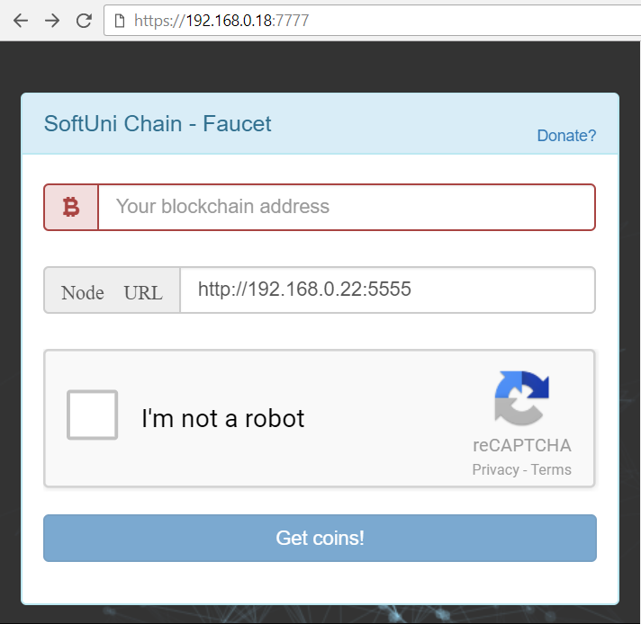
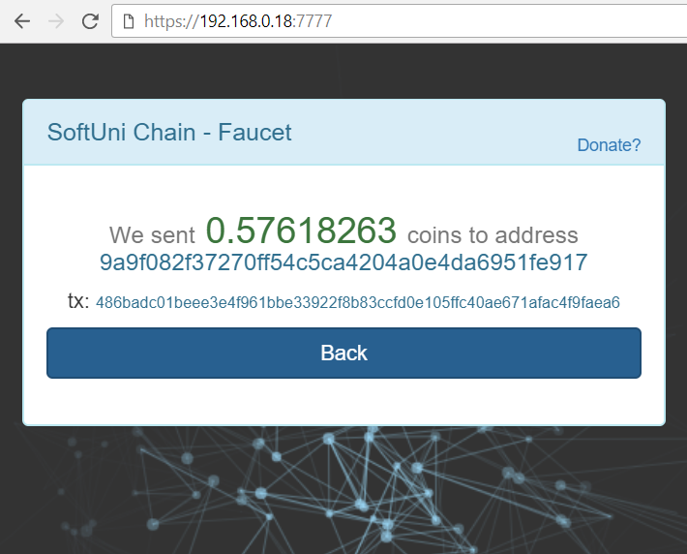
Faucet App

Slide 55
The Faucet App
The Faucet App is web applications that holds some coins
E.g. donated from the genesis transaction
Or mined by someone and donated to the faucet
The faucet works like a wallet with hard-coded private key
It sends a 1 coin (or less) to anyone who requests coins
Limits: one request per address per hour + captcha
For each request, the faucet creates a transaction, signs it and sends it to the specified Node URL (through HTTP POST)

Slide 56

Wallet App
Generating & Storing Keys, Check Account Balances, Signing & Sending Transactions

Slide 57
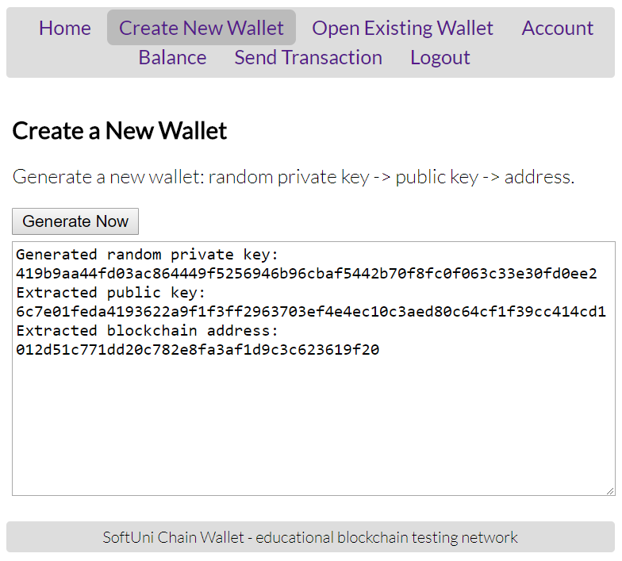
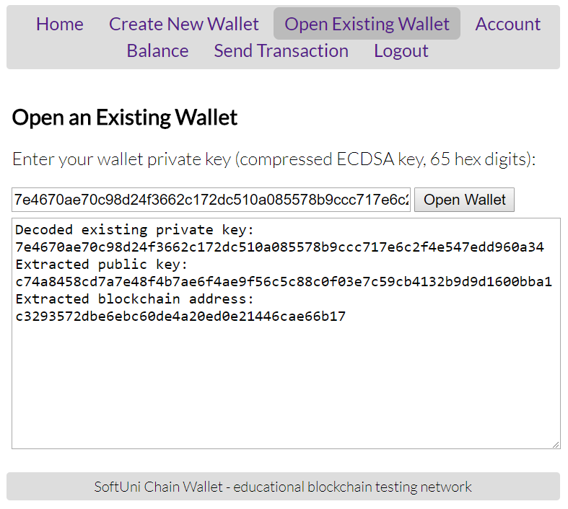
The Wallet App: Sample Screenshots

Slide 58
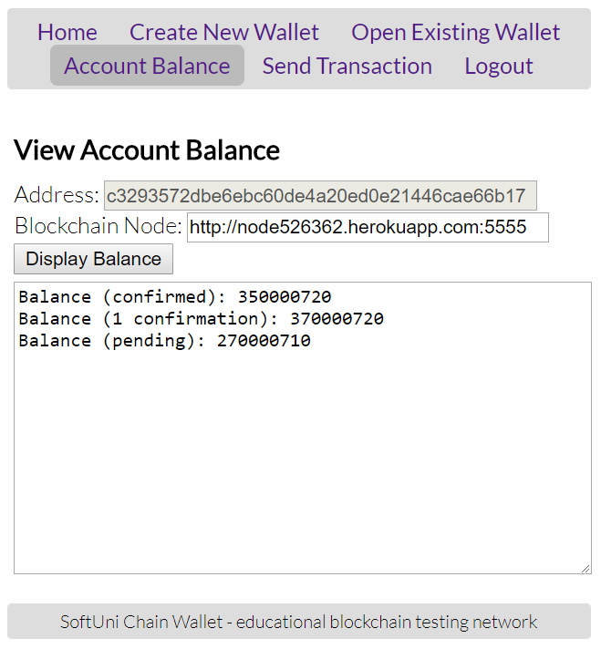
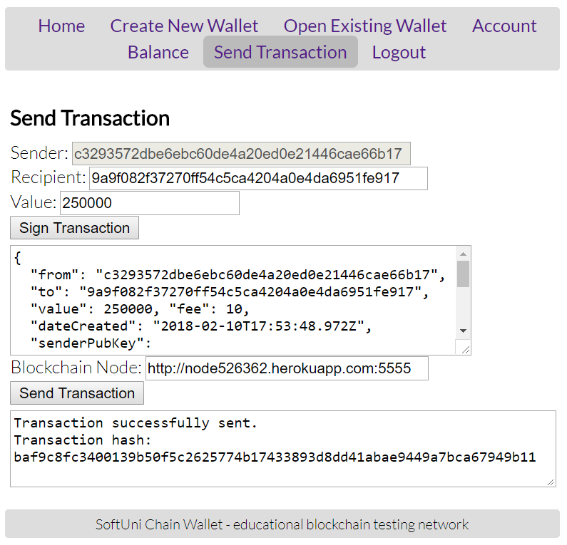
The Wallet App: Sample Screenshots (2)

Slide 59
Wallet App
The Wallet App is desktop / mobile / web application
Manages private keys + signs and sends transactions
It might be based on the HD wallet standards (BIP-39 / BIP-32)
Or for simplicity, could hold just a single private key
Functionality:
Create new wallet / open existing wallet (by data + password)
Check account balance (for certain private key's address)
Create, sign and send transactions

Slide 60
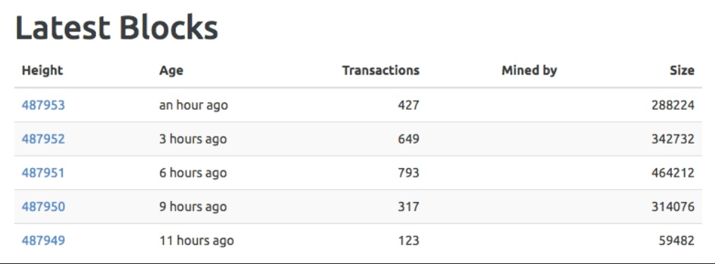
Block Explorer
Web App to Explore Blocks, Transactions, Accounts, Balances

Slide 61
Block Explorer
Implement the block explorer as Web app, at port 9999
Functionality:
View blocks
View confirmed transactions
View pending transactions
View accounts and balances
View peers
View network difficulty

Slide 62
How to Test the Blockchain?

Slide 63
Testing the Blockchain Network
A sample scenario to test the blockchain network
Run 4 nodes:
http://localhost:5555
http://localhost:5556
http://localhost:5557
http://localhost:5558
Connect them into two separate networks:
http://localhost:5555 <-> http://localhost:5556
http://localhost:5557 <-> http://localhost:5558

Slide 67
Building a Blockchain
http://www.kingsland.academy

